Slide 1
Front-End Web Development Using React (Client Side Technologies - CSS)
Front-End Web Development Using React – CSS
Eng. Reem Hassan Ahmed

Slide 2
Contents of this lecture
Introduction to CSS | What is CSS?
CSS selector types | Definition and exmaples on all css selector types
CSS properties | Definition and exmaple on every CSS property

Slide 3
02
CSS selector types
Front-End Web Development Using React – CSS

Slide 4
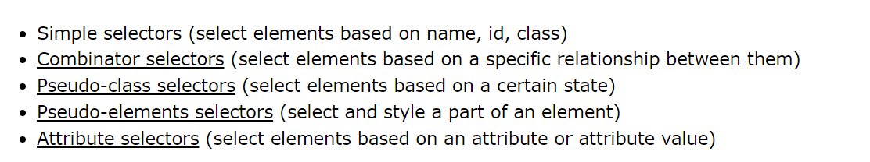
CSS selector types

Slide 5
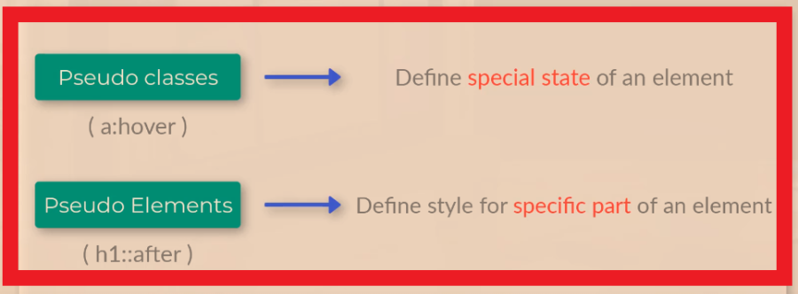
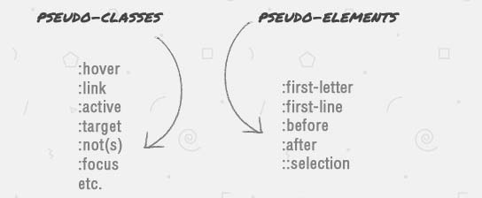
CSS selector types Cont.
Pseudo classes and elements:

Slide 6
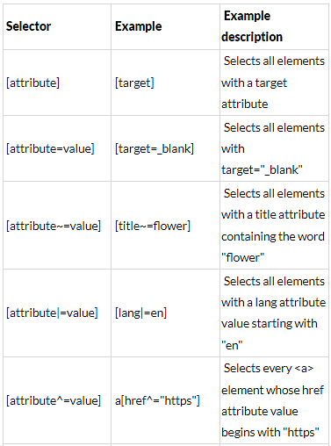
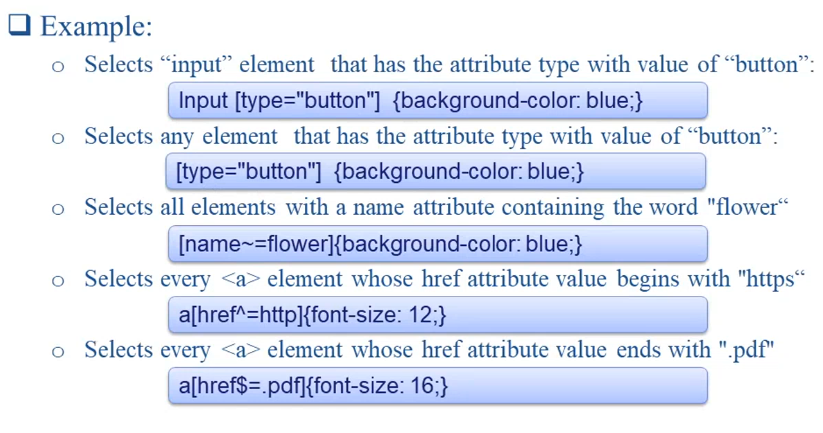
CSS selector types Cont.
Attribute selector:
The [attribute] selector is used to select elements with a specified attribute.

Slide 7
03
CSS properties
Front-End Web Development Using React – CSS

Slide 8
Table of contents
01
Backgrounds
04
Text
07
Display
02
Borders
05
Fonts
08
Position
03
Margin and padding
06
Lists
09
Forms

Slide 9
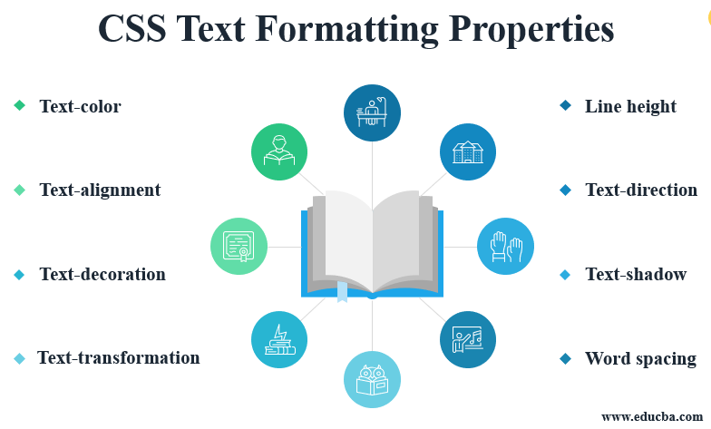
Text

Slide 10
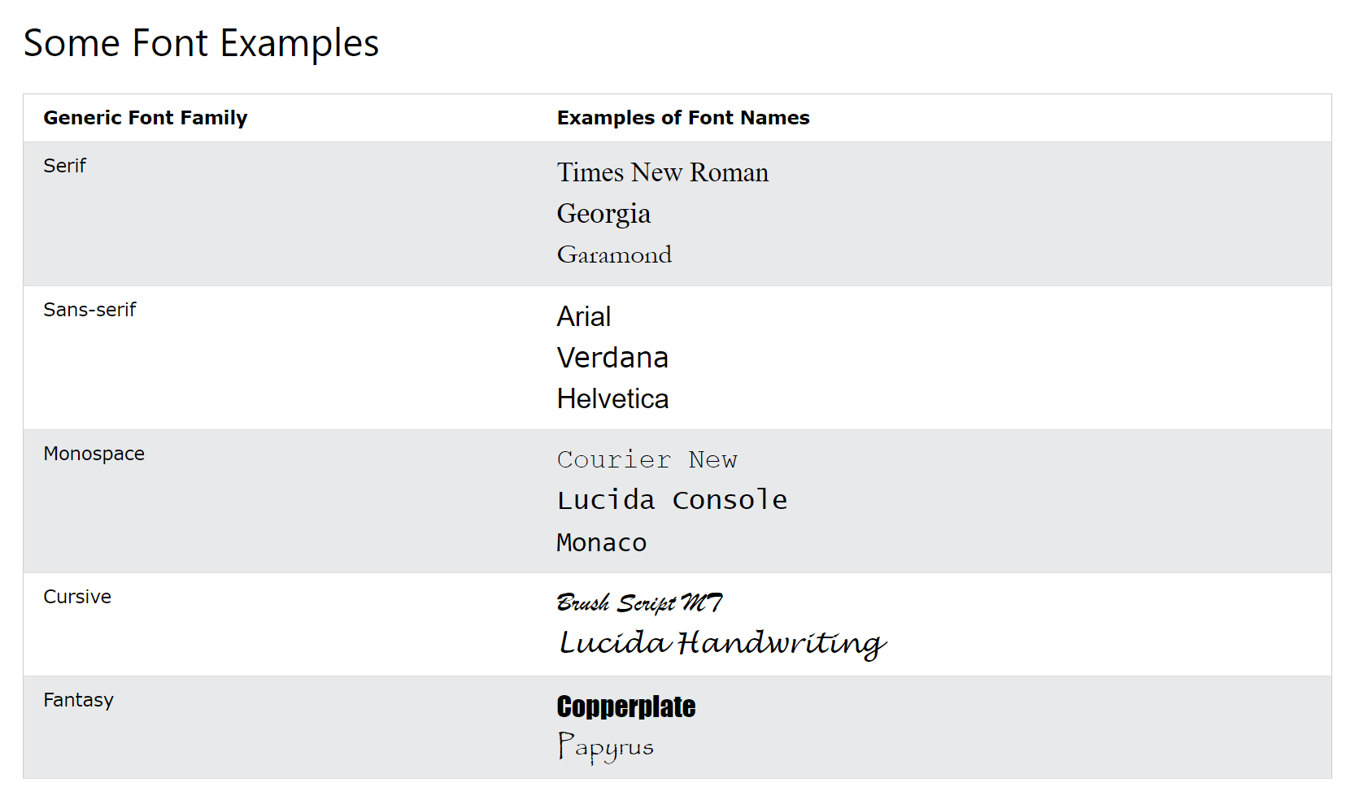
Fonts

Slide 11
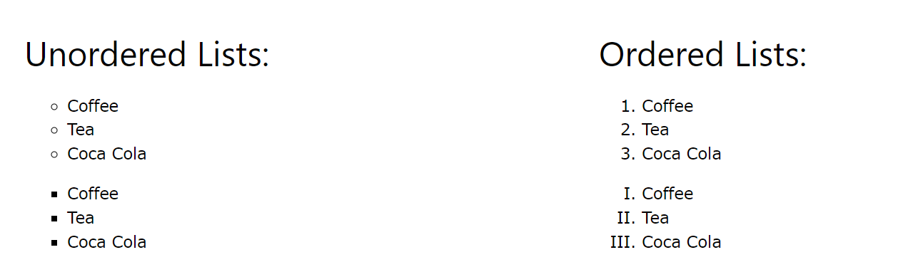
Lists

Slide 12
Display
Display types:
Block: The element starts on a new line.
Inline: Width and height cannot be changed.
Inline-block: Displayed as inline element but treated as block element.
None: The element is completely removed.
Visibility: hidden: The element will not appear in the page but its space will be reserved.

Slide 13
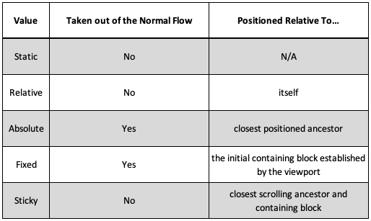
Position
Position types:
An element with position: static; is not positioned in any special way; it is always positioned according to the normal flow of the page:
An element with position: relative; is positioned relative to its normal position.
An element with position: fixed; is positioned relative to the viewport, which means it always stays in the same place even if the page is scrolled.
An element with position: absolute; is positioned relative to the nearest positioned ancestor (instead of positioned relative to the viewport, like fixed).
An element with position: sticky; is positioned based on the user's scroll position.

Slide 14

Forms

Slide 15
Thanks!
Front-End Web Development Using React – CSS
Does anyone have any question?
ReemHassan160299@gmail.com
+201092427577
Please keep this slide for attribution

